Slide 1
Quantum-Centric Supercomputing with Sample-Based Quantum Diagonalization and Qiskit Addons
Caleb Johnson
Kevin Sung IBM Quantum

Slide 2
Tutorial Agenda
Session 1
10:00-11:30 am MDT
Session 2
1:00-2:30 pm MDT
Quantum-Centric Supercomputing with Sample-Based Quantum Diagonalization (SQD) and Qiskit Addons
Intro to SQD
Tour of the software and Qiskit addons: qiskit-addon-sqd
Code demonstration for a chemistry application: Nitrogen molecule
Intro to SQD with quantum Krylov states
Code demonstration for a physics application: Anderson impurity model

Slide 3
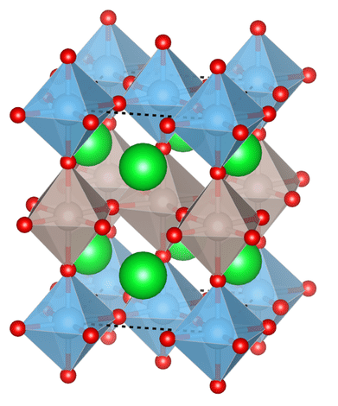
Quantum Algorithms for ground states
Goal: solving computationally challenging energy-estimation problems in quantum chemistry and materials
Applications: development of new materials, drug discovery, battery design
IBM Quantum
Notes:
In today’s presentation we will be focusing on the approximation of the ground-state properties of quantum many-body systems, which is generally an extremely challenging task for classical computers.
In addition to being potential candidates for quantum advantage, the approximation of the ground state of Hamiltonians is relevant in quantum chemistry and materials science, with a broad range of applications including the search for new materials and drugs, and battery design amongst others.
One of the most important properties of ground states is their energy. The knowledge of the ground state energy allows to, for example, find the equilibrium arrangement of atoms in molecules and materials, as well as identifying transition states in chemical reactions.

Slide 4
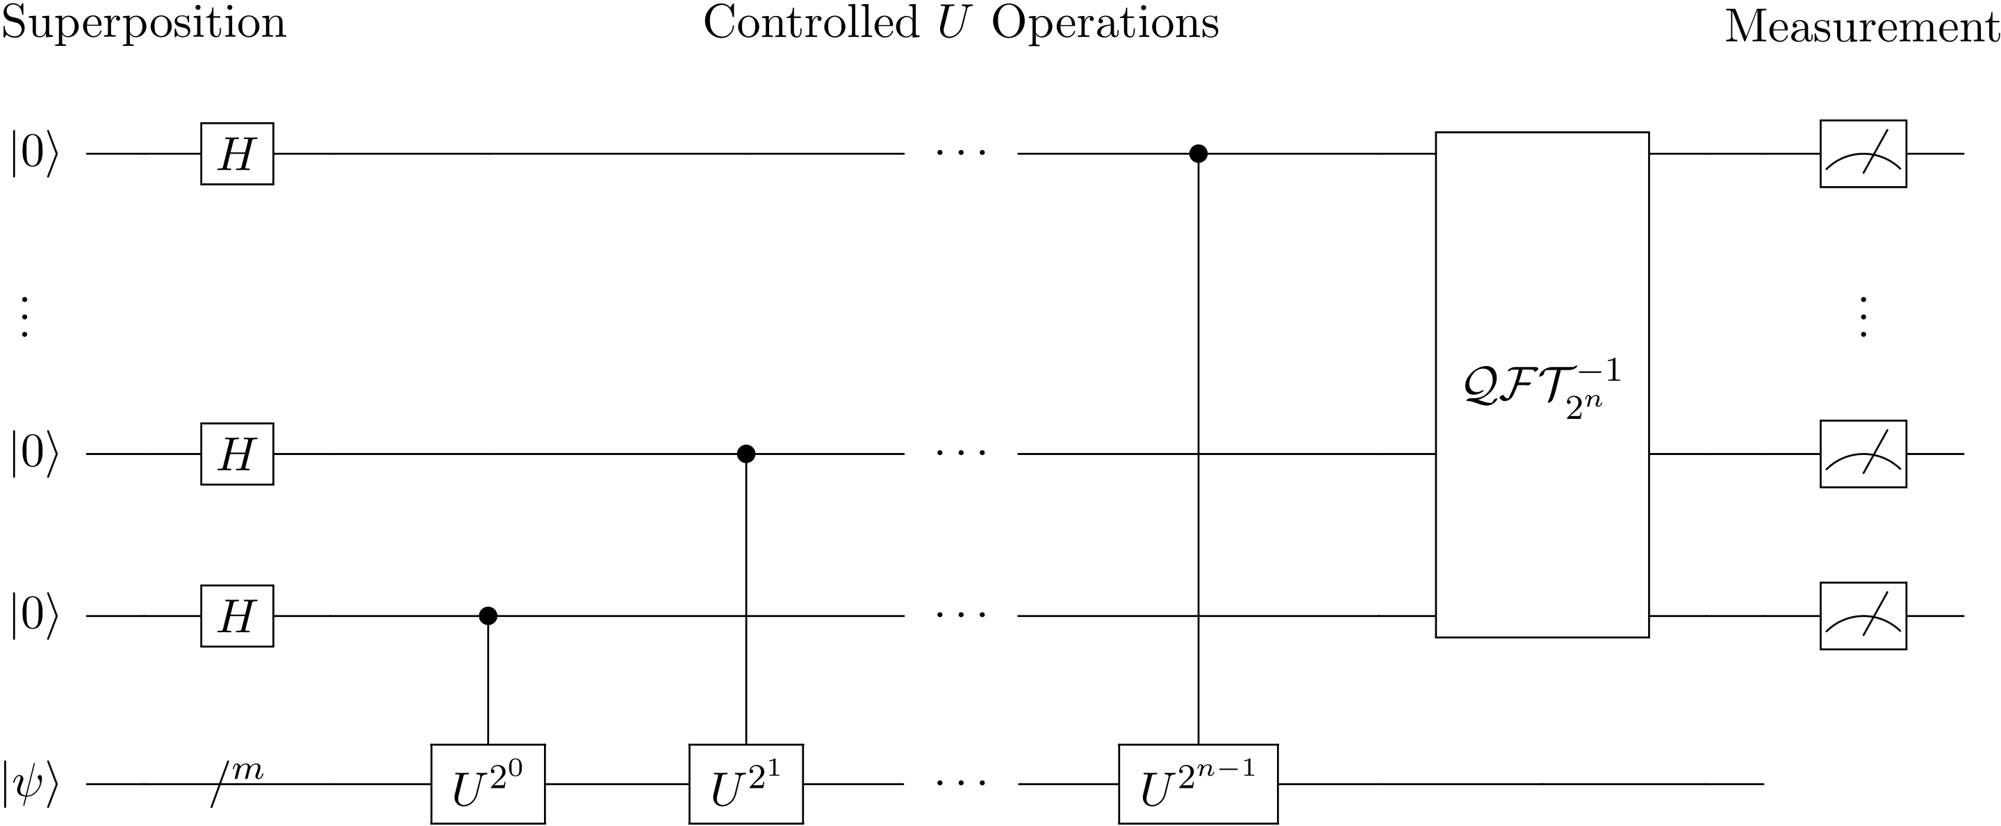
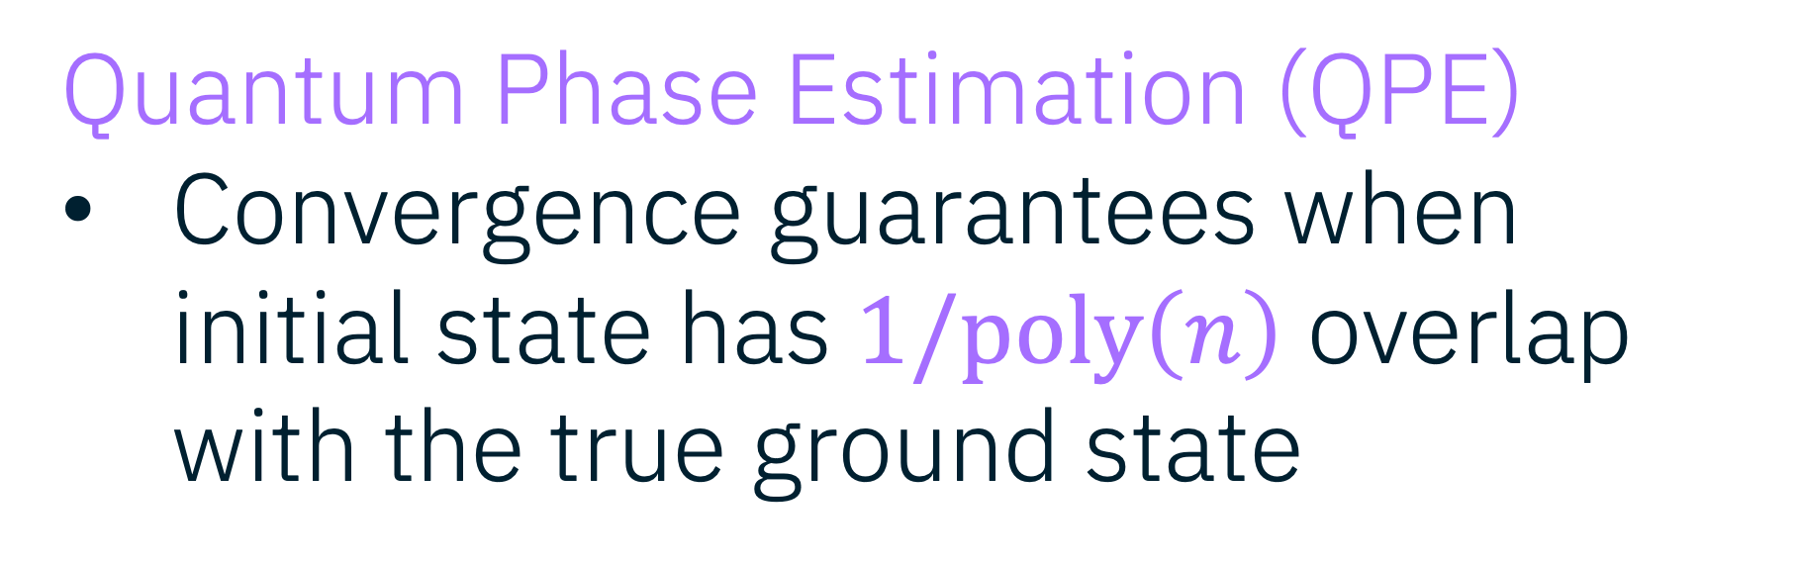
Prior algorithms in fault-tolerant era
Quantum Phase Estimation (QPE)
Convergence guarantees when initial state has $1/poly\left(n\right)$ overlap with the true ground state
Key Challenges
Requires deep quantum circuits and fault-tolerant quantum processors
IBM Quantum
Notes:
Ground-state energy estimation was one of the first proposals for the use of fault-tolerant quantum devices, with the so-called Quantum Phase Estimation algorithm. Remarkably, Quantum Phase Estimation is guaranteed to converge to the exact solution if an initial state can be provided with 1/poly(n) overlap with the actual ground state.
However, one of the key challenges with this algorithm is that it requires deep quantum circuits and fault-tolerant devices, making it not feasible on current quantum processors.

Slide 5
Prior algorithms in near term
Variational Quantum Algorithms (VQA)
May require shallow-depth circuits
Key challenges
No convergence guarantees
Measurement overhead for chemistry problems
Update parameters
Classical optimizer
IBM Quantum
Notes:
In order to circumvent the limitations of quantum-phase estimation, a plethora of near-term friendly algorithms have been used, which rely on the variational principle. These algorithms tend to rely on shallow and device-friendly circuits.
However, due to their heuristic nature, they lack convergence guarantees; and have immense measurement overheads that impede their application to large chemical problems.
The quantum-centric supercomputing framework, and in particular SAMPLE-BASED QUANTUM DIAGONALIZATION, has provided a workaround the measurement overhead problem. However, something that has been lacking from SQD is provable convergence.

Slide 6
Quantum-centric supercomputing
Can we perform reliable simulation of nature with provable convergence before fault-tolerant quantum computers?
IBM Quantum
Notes:
We want to address whether quantum centric supercomputing allows to perform reliable simulations of nature with provable convergence (like phase estimation), before the arrival of fault-tolerant quantum computers.
In this talk we will answer this question in the context of quantum-centric supercomputing. We will begin with the algorithm we introduced last year which is called sampled based Quantum Diagonalization (SQD)

Slide 7
Sample-based Quantum Diagonalization (SQD)

Slide 8
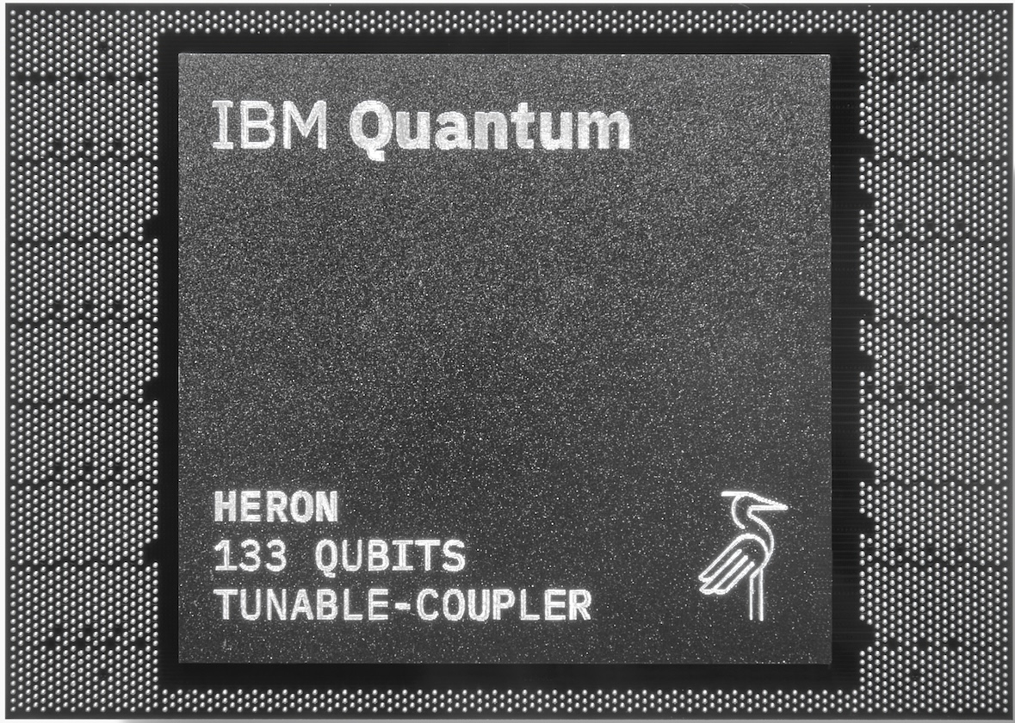

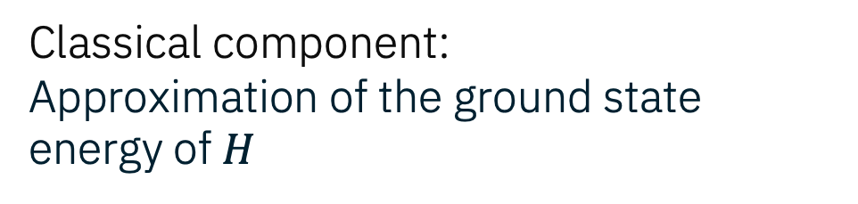
Sample-based Quantum Diagonalization (SQD)
Science Advances 11 (25), eadu9991 (2025)
Quantum compute generates samples from an exponentially large space
Classical component:
Approximation of the ground state energy of $H$
Sampler()
Configuration recovery
Projection and subspace diagonalization
Ground state properties
IBM Quantum
Notes:
Let’s begin by refreshing the overall workflow of Sample-Based quantum diagonalization (SQD), a quantum centric supercomputing algorithm to study the ground- and excited-state properties of interacting many-body systems.
First, we prepare a quantum circuit that represents a state Psi, and sample in the computational basis.
The main idea is that the samples will define the support of the target eigenstate.
Symmetries like particle-number conservation are used to recover the bitstrings that do not respect them, as a consequence of noise (configuration recovery).
Then the Hamiltonian is projected and diagonalized into the subspace (heavy classical calculation) and physical properties can be obtained from the approximate ground state.

Slide 9
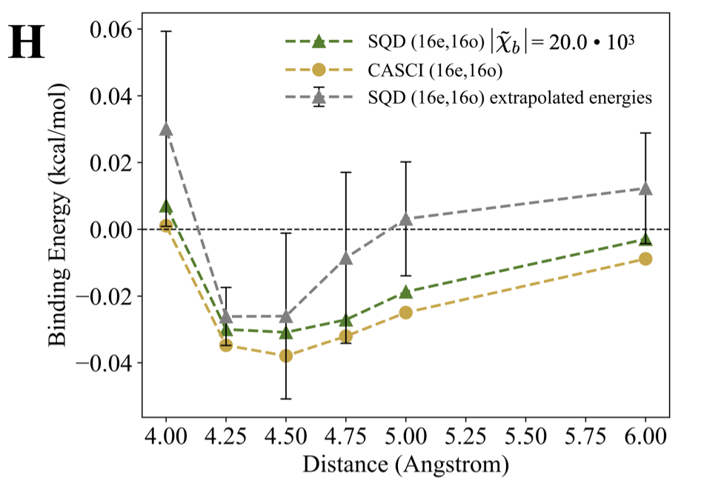
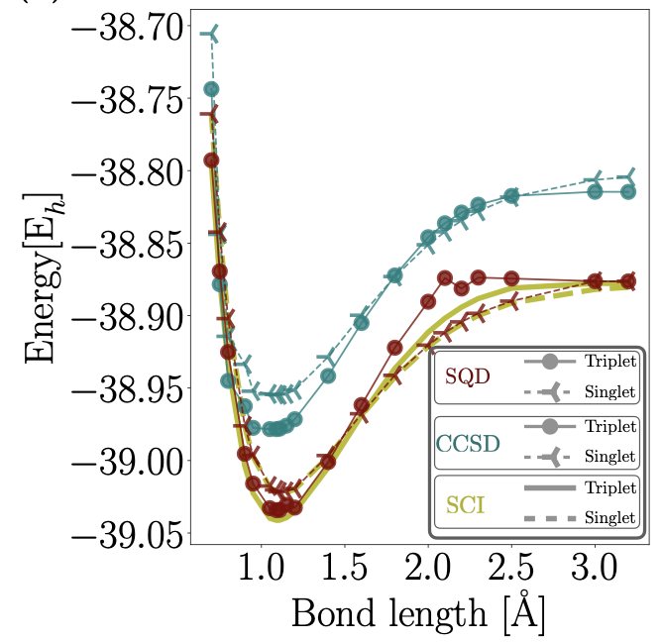
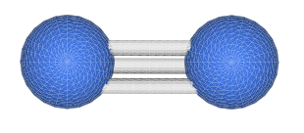


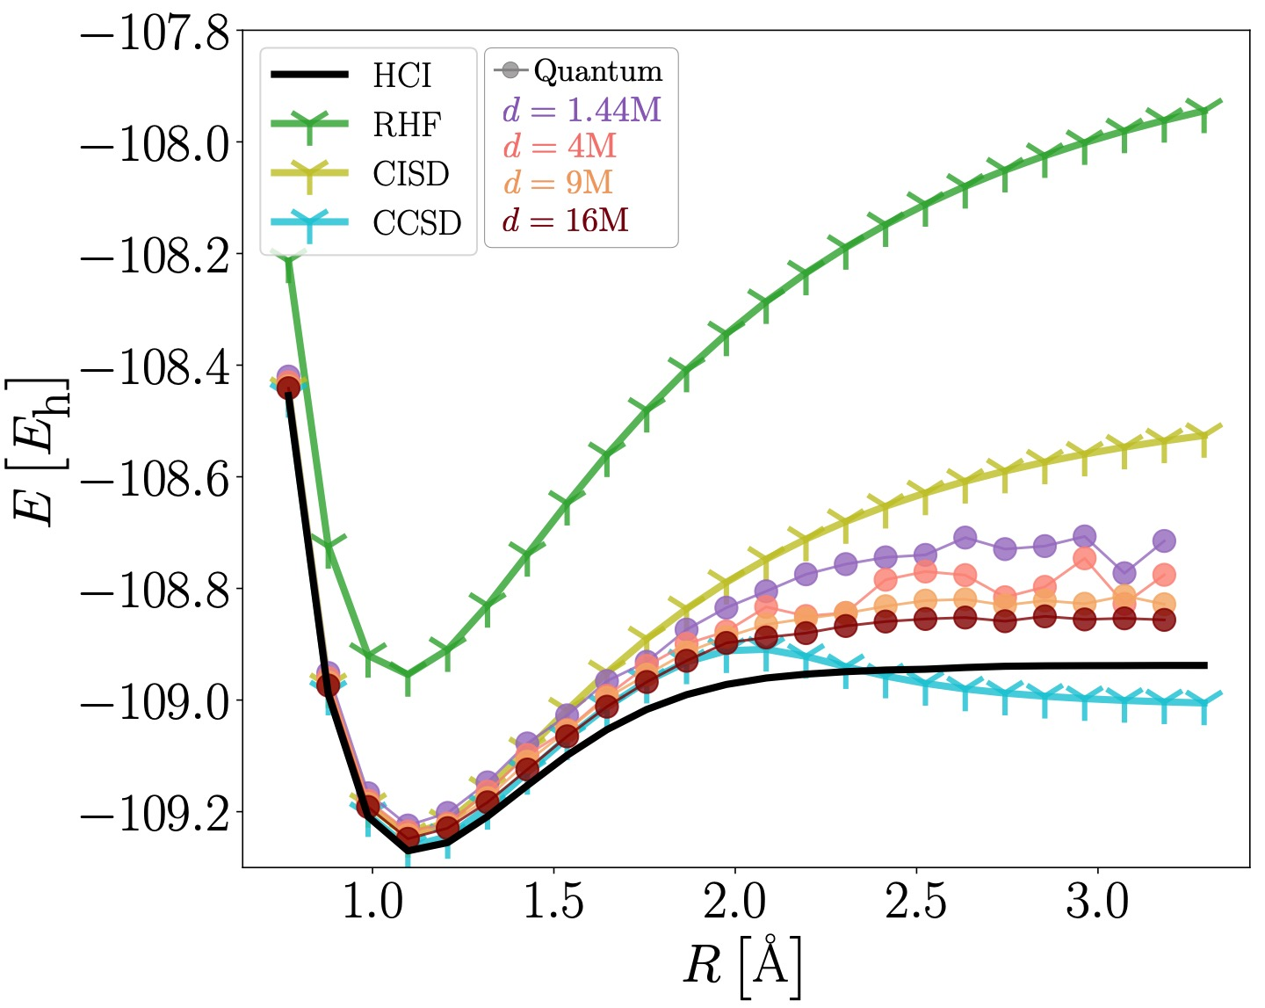
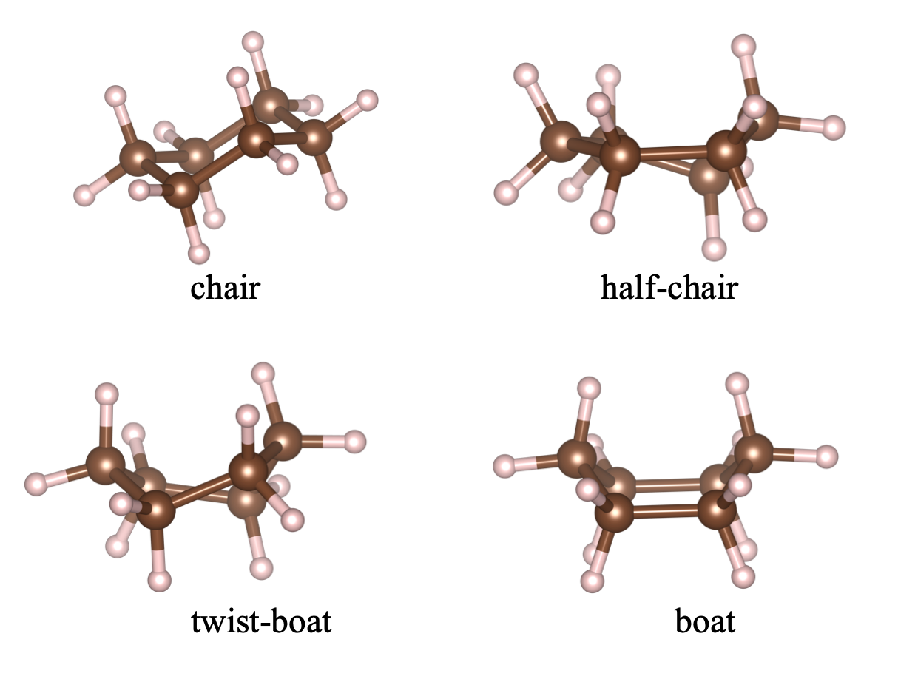
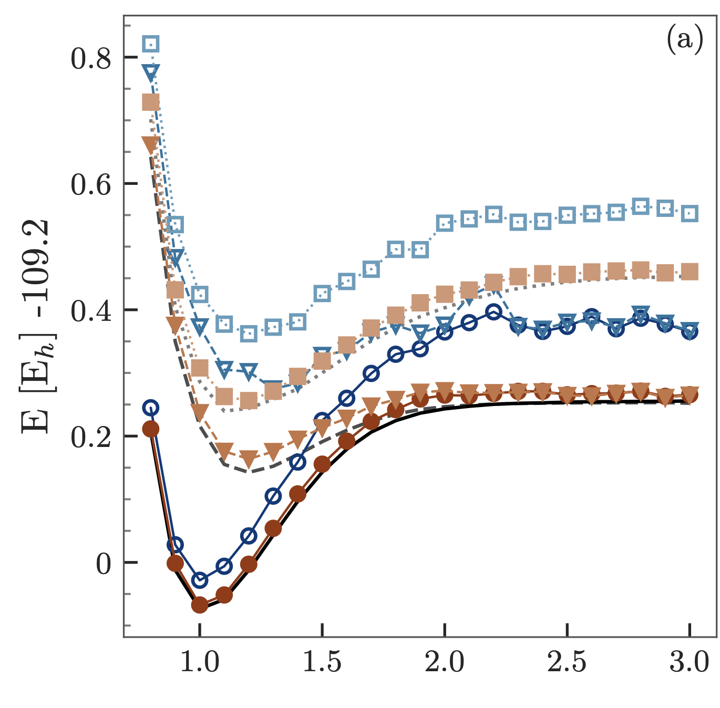

SQD for chemistry
check that all these examples are public
Remove 5k challenge box at bottom?
Chemistry beyond exact solutions…
High-precision SQD applied to supramolecular interactions
SQD applied to open-shell systems
52 qubits
1600 2-qubit gates
52 qubits
3500 2-qubit gates
IBM Quantum
IBM Quantum
DMET + SQD for organic chemistry
Ext-SQD: excited states
41 qubits
1500 2-qubit gates
58 qubits
1792 2-qubit gates
IBM Quantum
77 qubits
3500 2-qubit gates
IBM Quantum
84 qubits
5000 2-qubit gates
IBM Quantum
5k challenge on hydrogen chains
Notes:
SQD has redefined what is possible with quantum computers today for chemistry simulations.
In our collaboration with Riken, we run SQD, using the largest number of qubits in any electronic structure problem to date, to study the ground state properties of various molecular systems.
Since then, many follow-up studies have come up with some of our key partners and clients, some of which are highlighted in this slide.
Additionally, we extended SQD to make it amenable to study excited state properties
Despite its broad adaption, SQD lacks convergence guarantees, since the circuit construction is heuristic.

Slide 10
Looking forward | quality of the subspaces
No false positives
Numerics | Quantum circuits can produce subspaces of better quality than classical heuristics
Notes:
Like many classical methods, a key property of SQD is that it produces no false positives in the estimation of the ground state energy, allowing to unconditionally rank the quality of solutions coming from different approaches.
Additionally, over the last year, we have observed in numerical experiments that there exist quantum circuits that produce subspaces of better quality than classical heuristic methods on the [2Fe-2S] molecule.
In the energy-vs-subspace dimension plane, a lower energy means that a better-quality subspace has been found.
The points connected by arrows are the trajectory followed by a classical heuristic method.
While the green triangles correspond to an optimized quantum circuit.
We observe signifficantly lower energies for the same subspace dimensions, showing that there exist quantum circuits capable of producing better quality subspaces than existing classical heuristics
Despite its broad adaption and desirable properties, SQD lacks convergence guarantees, since the circuit construction is heuristic.

Slide 11
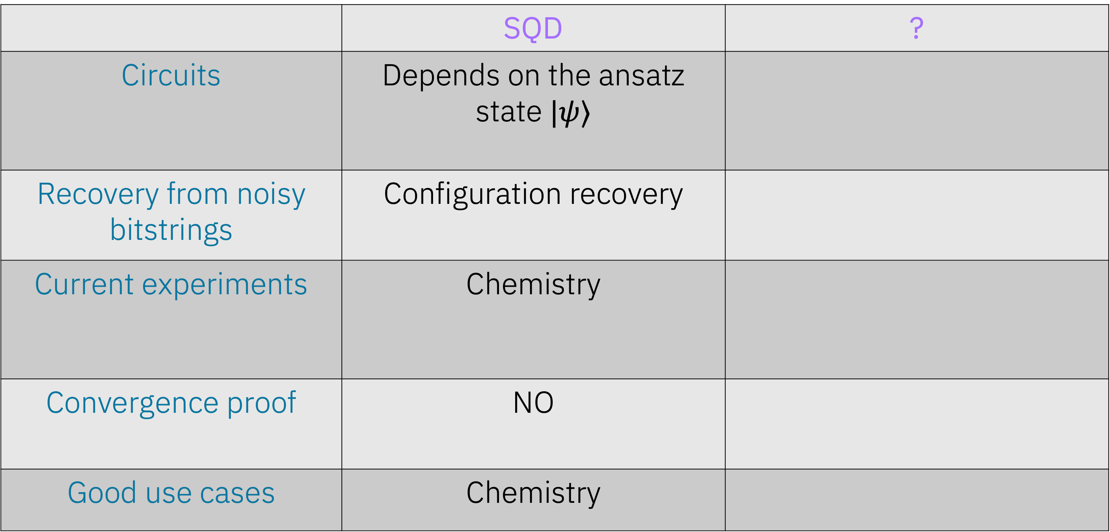
Quantum algorithms for spectrum estimation
 | SQD | ?
Circuits | Depends on the ansatz state $|ψ⟩$
Recovery from noisy bitstrings | Configuration recovery
Current experiments | Chemistry
Convergence proof | NO
Good use cases | Chemistry
Session 2
IBM Quantum
Notes:
Thanks Javier. We have discussed two quantum-centric algorithms for spectrum estimation. Let's do a comparison between them.
First question is what kind of circuits we need for these algorithms? Circuits for SQD depend on the ansatz state we prepare and for SKQD it depends on the reference state and the time dynamics circuits
For both SQD and SKQD we use configuration recovery to get signal from noisy bitstrings
Current experiments with SQD have been on chemistry, whereas for SKQD on Anderson models.
One critical difference is that SQD does not have any formal proof but in SKQD we can prove convergence under the sparsity of the ground state assumption
And in general, good use cases for SQD is chemistry and for SKQD, it's lattice models as we have presented in earlier slides

Slide 12
How do we choose the quantum circuits?
Heuristic
Physically-inspired ansatze (Local Unitary Cluster Jastrow)
Can either be optimized or initialized from approximate classical electronic structure methods
With convergence guarantees
?
Session 2
Science Advances 11 (25), eadu9991 (2025)
SQD
?
IBM Quantum

Slide 13
Heuristic circuits
IBM Quantum

Slide 14
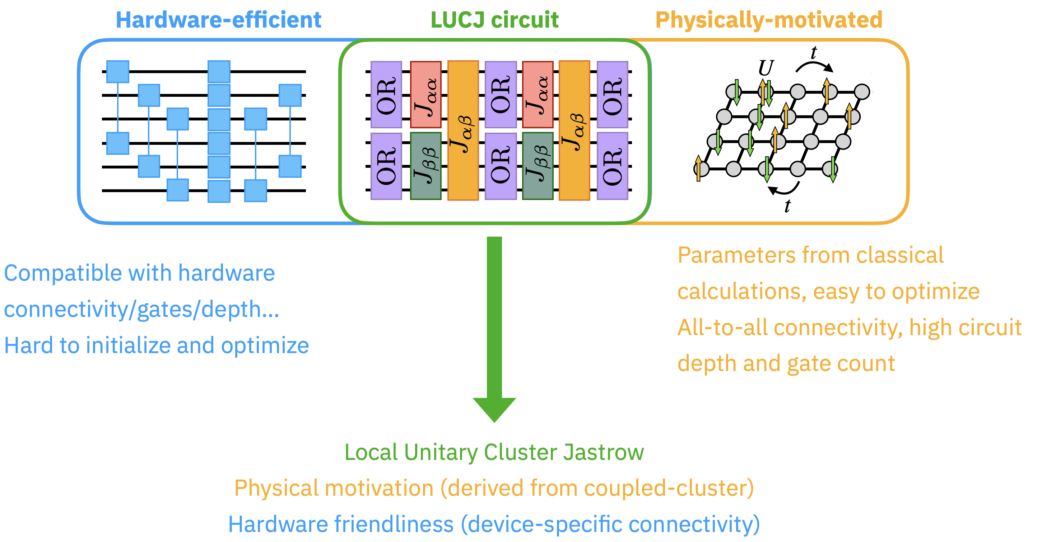
Circuits for chemistry: Local Unitary Cluster Jastrow
IBM Quantum
Motta, Sung, Whaley, Head-Gordon, Shee, Chem. Sci. 14, 40, 11213-11227 (2023)

Slide 15
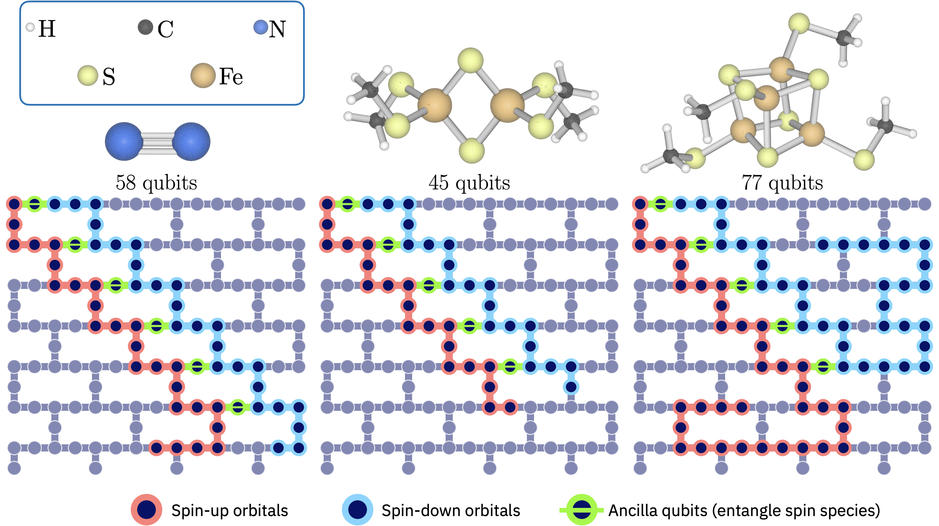
Circuits for chemistry: Local Unitary Cluster Jastrow
IBM Quantum
Science Advances 11 (25), eadu9991 (2025)

Slide 16
Brute-force requirements for chemistry and materials
Systems | Basis | Qubits | Memory vector storage | Reference
BeH | STO-3G | 6 | 1KiB | Nature 549, 242 (2017)
Fe₂S₂ | Cc-pvtz (DKH) | 40 | 2 GiB | SQD paper
N₂ | Cc-pvdz | 52 | 33 GiB | SQD paper
C₃H₈ | STO-3G | Classical | 7TiB | J. Chem. Theory Comput. 20, 1185 (2024)
Fugaku Storage | - | - | 4.85PiB | -
Front. Storage | - | - | 700 PiB | -
Fe₄S₄ | Cc-pvtz (DKH) | 72 | 63 PiB | SQD paper
Classical SOTA
IBM Quantum
Notes:
To put into perspective the magnitude of the SKQD experiments conducted, this table shows the memory required to store the exact ground state wave function.
The memory requirements to store the full ground state wave function corresponding to our experiments are orders of magnitude beyond electronic structure experiments to date.
The propane example is the largest classical exact diagonalization reported to date.
The largest experiment we have done is beyond the reach of current exact diagonalization calculations and greatly surpasses the SQD experiment in storage requirement for the exact ground state wave function by 8 orders of magnitude.
#Exact diagonalization has important memory requirements, e.g. to store a single CI vector (many-electron wavefunction)
#In addition to the memory requirements, exact diagonalization is combinatorially expensive in terms of floating-point operations
#C₃H₈ is propane. That was the largest classical brute force diagonalization done, at 1 Trillion determinants

Slide 17


SQD as an open-source Qiskit addon
ibm.biz/addon-sqd
IBM Quantum

Slide 18
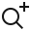
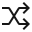


Qiskit addons build on the Qiskit SDK
Slide ID: 379
A collection of research capabilities developed as modular tools that can plug into a workflow to design new algorithms at the utility scale
AQC-Tensor
OBP
SQD
MPF
Circuit cutting
M3
Qiskit Circuit Library
Transpiler
Transpiler
Primitives
Quantum Info
Input: Domain inputs
Output: Circuits, observable
Input: Circuits, observable
Output: ISA circuit, observable
Input: ISA circuit, observable
Output: Expectation value/samples
Input: Expectation value/samples
Output: Data objects/visualizations
Map
Optimize
Execute
Post-Process
Notes:
This is why we launched Qiskit addons.
Qiskit addons are a collection of research capabilities developed as modular power tools that can plug into a workflow to design new algorithms at the utility scale.
We’ve designed these addons to be modular so that you can integrate them into your code without having to totally restructure your pipeline. These are power tools that make it easier to leverage advanced research capabilities out of the box without having to start from scratch.
One of these addons is for sample-based quantum diagonalization (SQD) which is the focus of this tutorial

Slide 19
<summary of main features>
finish me!
Overview of the SQD Qiskit addon

Slide 20

Code demonstration for a chemistry application: Ground state of the nitrogen molecule
ibm.biz/sqd-tutorial-chemistry

Slide 21
Tutorial Agenda
Session 1
10:00-11:30 am MDT
Session 2
1:00-2:30 pm MDT
Quantum-Centric Supercomputing with Sample-Based Quantum Diagonalization (SQD) and Qiskit Addons
Intro to SQD
Tour of the software and Qiskit addons: qiskit-addon-sqd
Code demonstration for a chemistry application: Nitrogen molecule
Intro to SQD with quantum Krylov states
Code demonstration for a physics application: Anderson impurity model

Slide 22
Sample-based Krylov Quantum Diagonalization (SKQD)

Slide 23
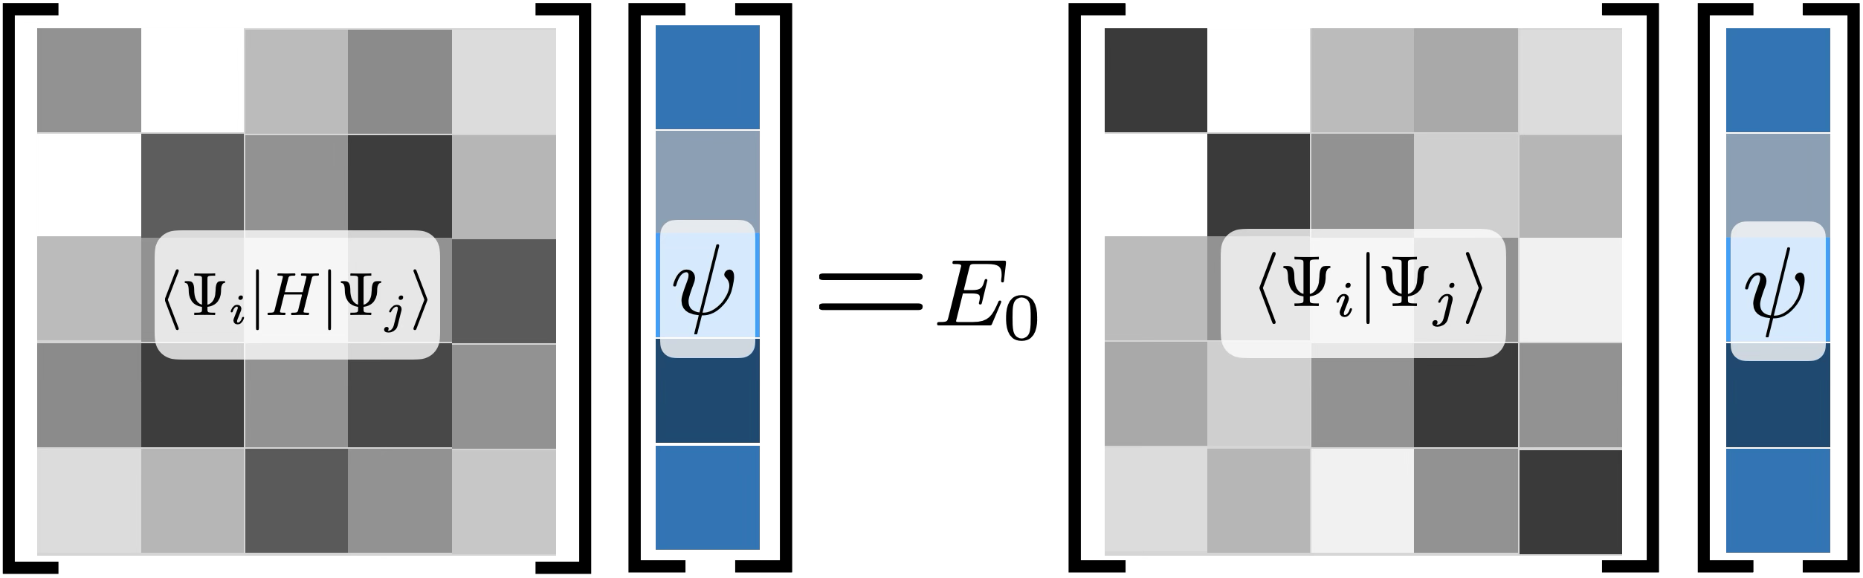
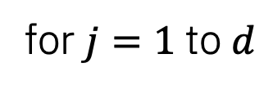

Preliminaries: Krylov quantum diagonalization
Quantum component
Classical component: Approximation of the ground state energy of $H$
Krylov quantum states
subspace diagonalization in the Krylov subspace
Projection in the Krylov subspace
for $j=1$ to $d$
Ground state properties
Reference state
IBM Quantum
Notes:
As Javier just noted, our sample-based quantum diagonalization method or SQD is an excellent technique for chemistry applications, since in that setting, we have good heuristically-motivated circuits to sample from an appropriate approximation of the ground state.
However, for materials simulations, we would instead be focusing on lattice models, where it is less clear whether we can hope for any single circuit to directly prepare a ground state approximation.
On the other hand, for lattice models we have an option that is much more challenging for chemistry: simulating time evolution under the model we want to study.
I'm now going to build up to describing a second quantum-centric algorithm that uses this resource, but to understand it, I first have to describe a preliminary algorithm known as Krylov quantum diagonalization.
The idea in Krylov quantum diagonalization is to start with some initial reference state, phi_ref, and use the quantum processor to prepare a number of different time evolved states starting from it, with equally-spaced time intervals.
These time evolved states form the basis for a subspace, which is called a Krylov space.
In Krylov quantum diagonalization, we use the quantum computer to prepare these basis states, and then estimate matrix elements of the Hamiltonian we want to study between all pairs of them – that is this matrix here with psi_i, H, psi_j
Kunal: maybe the rest on this slide is too dense. We can just say that we prepare the states and perform projection in the Krylov subspace on a quantum processor and the rest of the steps are analogous to SQD, where we solve subspace diagonalization in the Krylov subspace.
We also use the quantum computer to estimate their overlaps, which is this matrix on the other side with just psi_i, psi_j
I'm not going to get into the details of how we can estimate these on the quantum computer, but once we have done that, we have these two d by d matrices, and we can classically solve a matrix equation to obtain an approximation of the lowest energy of the original Hamiltonian.
This might look like a bit of magic, and it kind of is, but the main things to know are that these Krylov methods are very well known on the classical computing side, and what the quantum computer contributes is to let us apply them to Hilbert spaces of exponential dimension, i.e. to large quantum systems.

Slide 24
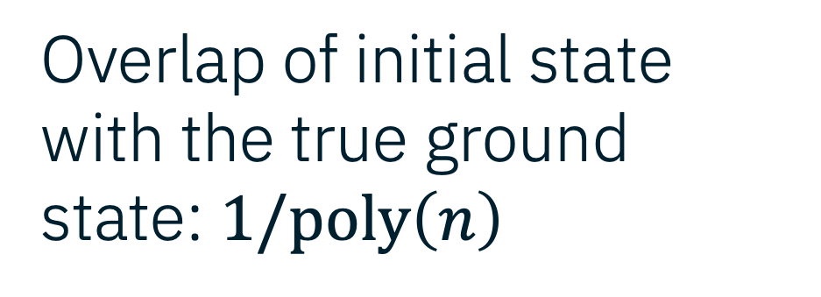

Preliminaries: Krylov quantum diagonalization
Overlap of initial state with the true ground state: $1/poly\left(n\right)$
Gap: $1/poly\left(n\right)$
Ground state error converges efficiently with increasing # circuits and shots
Experimental result (arxiv:2407.14431): computed eigenenergies of quantum many-body systems on two-dimensional lattices of up to 56 sites
IBM Quantum
Notes:
In particular, one thing that is known on the classical side is that Krylov diagonalization methods converge exponentially quickly with respect to the number d of states that you prepare, which means that in practice d doesn't have to be too large.
It turns out that we can prove that this is true on the quantum side as well, and extend that to a full end-to-end error bound for the algorithm even in the presence of noise on the quantum device.
I will spare you the details of that result, but the main takeaways from it are that we need two things to be able to know that the algorithm will converge to the true ground state:
First, we need a good initial reference state.
What "good" means is exactly the same as in quantum phase estimation, which is the very famous algorithm for estimating ground state energies on fault-tolerant quantum computers: as Antonio mentioned in his introduction, for quantum phase estimation to be efficient, you need an initial state whose overlap with the true ground state vanishes at most polynomially-quickly, not exponentially quickly.
We need exactly the same thing in order for Krylov quantum diagonalization to converge.
And secondly, in order to converge to the ground state itself, we require a spectral gap, that is the gap between ground state energy and first excited energy, that also vanishes at most polynomially-quickly in the number of qubits.
So these are exactly the same two requirements for quantum phase estimation to converge, and while the details of the convergence rates of the two algorithms are different, at the very high level you can think of them as similar, just Krylov quantum diagonalization is more near-term friendly.

Slide 25
Motivating questions
Can we leverage the strengths of SQD and Krylov to approximate the ground state energies of interesting Hamiltonians?
Can we perform reliable and verifiable simulation of nature with provable convergence on pre-fault-tolerant quantum computers?
IBM Quantum
Notes:
Now, I just claimed that Krylov quantum diagonalization is more near-term friendly than quantum phase estimation, and it certainly is, but we still may hope for something better.
Javier discussed SQD and the fact that one its key strengths is that the energies coming from it are classically verifiable and variational: the estimates we get are always above the true ground state energy, so that we always know that lower is better.
We like the Krylov quantum diagonalization algorithm because it has provable convergence and it is very broadly applicable in theory, but it doesn't have such nice classical verifiability, and it can yield negative energy errors, so we don't have any directly way of knowing how accurate its results are in comparison to other competing methods.
That motivates the algorithm that I am going to discuss next, and we can frame the motivation in terms of these two questions: can we somehow combine the strengths of the to methods we've discussed so far to obtain a new algorithm that is reliable and verifiable like SQD, and has provable convergence like Krylov quantum diagonalization?

Slide 26
Sample-based Krylov Quantum Diagonalization (SKQD)
Simple states to prepare that have good overlap with ground states
Sampler()
Quantum devices are naturally suited for performing time-evolution circuits.
IBM Quantum
Notes:
The answer is yes, and comes in the form of an algorithm that we created last summer with actually a couple of our summer interns, which we named sample-based Krylov quantum diagonalization or SKQD to recall the fact that it is a hybrid of the two algorithms we've already discussed.
The idea in SKQD is pretty simple.
I told you before that in Krylov methods we use the quantum computer to prepare Krylov states, these time evolved states psi_j
Before, in regular Krylov quantum diagonalization, we used the quantum computer both to prepare those states and to calculate matrix elements of the Hamiltonian between them.
In SKQD, the modification we make is to simply sample from the Krylov states, like we do for the single ansatz state in SQD.
So there is no calculation of matrix elements on the quantum computer, just time evolutions follewed by sampling.

Slide 27


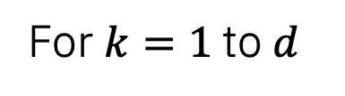

SKQD: algorithm
Sampler()
Approximation of the ground state energy of $H$
Configuration recovery
For $k=1$to $d$
Projection and subspace diagonalization
Krylov time-evolved states
Ground state properties
IBM Quantum
arXiv:2501.09702
Notes:
Now you may immediately ask: what do you do with the samples?
Wasn't the calculating of matrix elements corresponding to the Krylov space important?
The answer, it turns out, is that we can take all of those samples from all of the different Krylov states, batch them into one big pool of bitstrings, and then proceed exactly as we did in SQD: apply configuration recovery to them, then project the Hamiltonian onto them and diagonalize to obtain the approximate ground state.
You may now reasonably ask whether this really works...

Slide 28
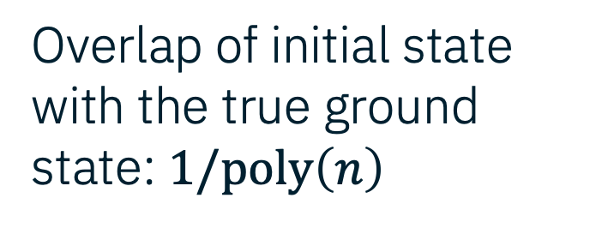

SKQD: convergence guarantees
Krylov quantum diagonalization
SQD
Overlap of initial state with the true ground state: $1/poly\left(n\right)$
Gap: $1/poly\left(n\right)$
Sparse ground state
Ground state error converges efficiently with increasing # circuits and shots
IBM Quantum
arXiv:2501.09702
Notes:
Luckily for us, we were able to prove that this hybrid algorithm between Krylov quantum diagonalization and SQD yields a hybrid of their two error analyses:
Like Krylov quantum diagonalization, it requires a good initial state and spectral gap in the sense I discussed before, which is also like quantum phase estimation.
And like SQD, the price we pay for the sampling is that we require the ground state to be sparse in order to obtain a good approximation with just the sampled bitstrings.
But given those three conditions, we can prove that the approximate ground state from SKQD will converge to the true ground state efficiently with respect to the number of shots we take and number of distinct circuits or Krylov states we sample from.

Slide 29
SKQD: key takeaways
No false positives for ground states: estimations are always upper bounds on the true ground-state energy
Its performance has a provable convergence for sparse ground states given good initial reference state
No ansatz required: wavefunction ansatz is replaced with a reference state, followed by time evolution circuits
IBM Quantum
Notes:
So let me summarize the key theoretical takeaways about SKQD, before I hand it back to Javier to discuss our first experimental results using this algorithm
First: like SQD, we have no false positives in the sense that we are guaranteed to get ground state energies that lie above the true ground state energy.
That means that we know that if the output energy goes down, we have a better approximation, which is a key advantage over the original Krylov algorithm.
Second: like the original Krylov algorithm, as long as we have a good initial state, and now additionally require a sparse ground state, we can prove that the algorithm will converge efficiently, which is a key advantage over SQD.
And finally: unlike SQD, we don't need to come up with a good heuristic ansatz for the ground state – all we need is our initial reference state, which only has to have a good overlap with the true ground state, and time evolutions of it.
The convergence guarantees of Krylov methods will handle the rest.
This is the second key advantage over SQD, in particular for materials and lattice model simulations, which is how I started out motivating this algorithm.
For these systems, unlike chemistry systems, we don't necessarily have access to a good ansatz for the ground state, but we can simulate time evolutions on the quantum computer as Javier will shortly discuss, and SKQD lets us leverage that to approximate the ground state without the need for an ansatz.
With that I will hand it back to Javier to discuss our first experimental results using this algorithm in collaboration with Oak Ridge National Lab.

Slide 30
SKQD: first experiments
arXiv:2501.09702
Single-impurity Anderson model
Free electrons coupled to interacting impurities
Relevant to simplify real materials calculations on DMFT workflows
Extensively used to benchmark numerical techniques
IBM Quantum
Notes:
The requirements to implement SKQD in today’s hardware are two:
We require the ground state to be sparse. This is satisfied by a number chemistry problems.
A number of Trotter steps must be able to be compiled within the 5k 2-qubit gate vicinity. This is not the case for chemistry problems whose Hamiltonians are comprised of millions of Pauli operators, leading to circuits whose depth exceeds the capabilities of todays devices.
This is where impurity models come into play:
An impurity model consists of a number of non-interacting electrons (bath), as depicted by this conduction band, and a small number of degrees of freedom where the electrons are allowed to interact amongst each other (impurity).
It’s ground state is expected to be sparse due to the non-interacting nature of many of its degrees of freedom, and its time evolution can be compiled into circuits whose depth is less than 5k 2-qubit gates.
Not only is it a good model to describe the physics of magnetic impurities in conductors, but it is of extreme relevance in realistic materials calculations. The solution of an impurity models is a critical part of the so-called Dynamical Mean Field Theory, a numerical technique to study the properties of materials.
Additionally, the single-impurity Anderson model has been extensively used as a testbed for approximate numerical many-body techniques. And in particular, the properties of the Single Impurity Anderson Model are very well understood.

Slide 31
SKQD: first experiments
arXiv:2501.09702
DMRG: ground truth
85 qubits
6k 2-qubit gates (25 Trotter)
Excellent agreement in the ground-state energy estimation
Accuracy increases as interactions increase | higher sparsity
IBM Quantum
Notes:
Thanks to its extensive study, it is known that the ground state produced by the Density Matrix Renormalization Group (DMRG), a classical technique, may be taken as the ground truth.
We focus on a system with 1 impurity site and 41 bath sites, and a total number of 42 electrons. Under the Jordan-Wigner transformation, this system gets mapped into 85 qubits. We gathered samples up to 25 Trotter steps, which is a circuit with 6k two-qubit gates.
We compute the ground state energy using SKQD for different values of the impurity onsite repulsion strength U, and obtain the error, relative to DMRG in the ground state energy, as shown in this bar plot. Since the SKQD energy estimate is an upper bound to the ground state energy, this is a meaningful quantity to compute. The lower the energy error, the closer the solution is to the ground truth.
For SKQD (coral bars), the error is below 10e-4 and decreases as U is increased, due to the increased sparsity of the ground state. This is in contrast to some other classical approximate methods (CCSD and HF), whose error increases as the interaction strength grows.

Slide 32
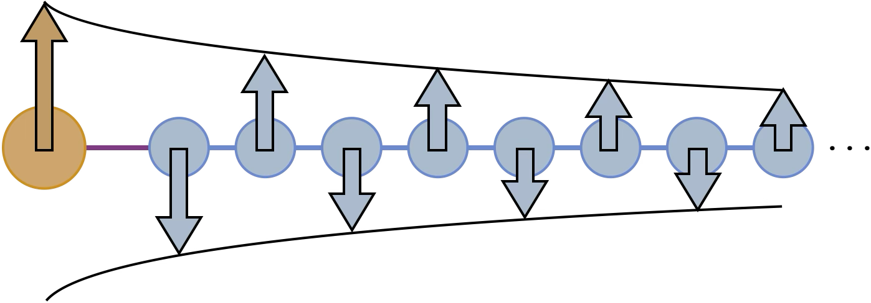
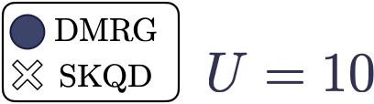
SKQD: first experiments
arXiv:2501.09702
Excellent agreement in other physical properties
IBM Quantum
Notes:
On the left panel, we show the device layout that was used for the 85-qubit experiment. The red and blue chains correspond to spin-up and spin-down degrees of freedom respectively, while the green qubit is used to mediate the onsite interaction in the impurity.
Correlation functions are very informative physical quantities to study, since they describe the response generated by a local event in the rest of the system. For impurity models, it is relevant to understand the response of the bath to a given state in the impurity. They are relevant to understand whether the state of the system is ordered or disordered, and in what distance scales the order stays.
For instance, consider the 2-point spin correlation function, which describes how the spins of the electrons in the system to a certain magnetic state in the impurity. In this case, the coupling is anti-ferromagnetic and decays with the distance to the impurity.
The plot in the right-hand side compares the 2-point spin correlator obtained from SKQD experiments (white crosses), to that obtained from DMRG (blue circles), showing excellent agreement of the SKQD estimations with the DMRG ones.

Slide 33
Brute-force requirements for chemistry and materials
Systems | Basis | Qubits | Memory vector storage | Reference
BeH | STO-3G | 6 | 1KiB | Nature 549, 242 (2017)
Fe₂S₂ | Cc-pvtz (DKH) | 40 | 2 GiB | SQD paper
N₂ | Cc-pvdz | 52 | 33 GiB | SQD paper
C₃H₈ | STO-3G | Classical | 7TiB | J. Chem. Theory Comput. 20, 1185 (2024)
Fugaku Storage | - | - | 4.85PiB | -
Front. Storage | - | - | 700 PiB | -
Fe₄S₄ | Cc-pvtz (DKH) | 72 | 63 PiB | SQD paper
SIAM (41 bath) | Lattice model | 84 | 2.06 * 10⁹ PiB | SKQD paper
Classical SOTA
IBM Quantum
Notes:
To put into perspective the magnitude of the SKQD experiments conducted, this table shows the memory required to store the exact ground state wave function.
The memory requirements to store the full ground state wave function corresponding to our experiments are orders of magnitude beyond electronic structure experiments to date.
The propane example is the largest classical exact diagonalization reported to date.
The largest experiment we have done is beyond the reach of current exact diagonalization calculations and greatly surpasses the SQD experiment in storage requirement for the exact ground state wave function by 8 orders of magnitude.
#Exact diagonalization has important memory requirements, e.g. to store a single CI vector (many-electron wavefunction)
#In addition to the memory requirements, exact diagonalization is combinatorially expensive in terms of floating-point operations
#C₃H₈ is propane. That was the largest classical brute force diagonalization done, at 1 Trillion determinants

Slide 34
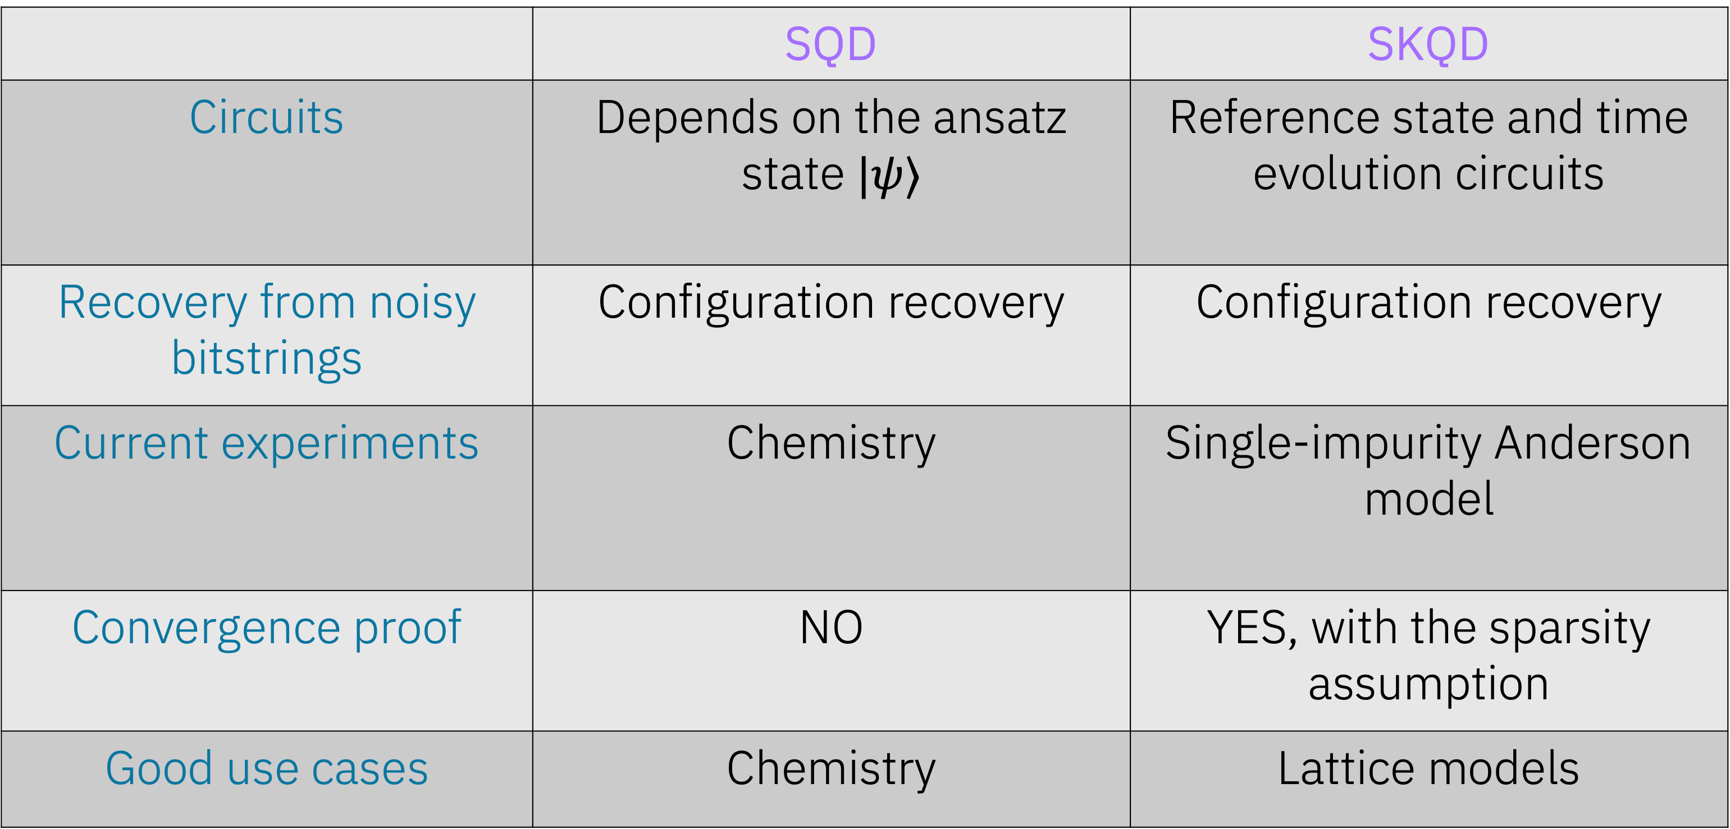
Quantum algorithms for spectrum estimation
 | SQD | SKQD
Circuits | Depends on the ansatz state $|ψ⟩$ | Reference state and time evolution circuits
Recovery from noisy bitstrings | Configuration recovery | Configuration recovery
Current experiments | Chemistry | Single-impurity Anderson model
Convergence proof | NO | YES, with the sparsity assumption
Good use cases | Chemistry | Lattice models
IBM Quantum
Notes:
Thanks Javier. We have discussed two quantum-centric algorithms for spectrum estimation. Let's do a comparison between them.
First question is what kind of circuits we need for these algorithms? Circuits for SQD depend on the ansatz state we prepare and for SKQD it depends on the reference state and the time dynamics circuits
For both SQD and SKQD we use configuration recovery to get signal from noisy bitstrings
Current experiments with SQD have been on chemistry, whereas for SKQD on Anderson models.
One critical difference is that SQD does not have any formal proof but in SKQD we can prove convergence under the sparsity of the ground state assumption
And in general, good use cases for SQD is chemistry and for SKQD, it's lattice models as we have presented in earlier slides

Slide 35
How do we choose the quantum circuits?
Heuristic
Physically-inspired ansatze (Local Unitary Cluster Jastrow)
Can either be optimized or initialized from approximate classical electronic structure methods
With convergence guarantees
Sample from the members of a Krylov basis
Time-evolution circuits may be hardware friendly and are a Krylov basis
Not suitable for ab-initio
Science Advances 11 (25), eadu9991 (2025)
arXiv:2501.09702
SQD
SKQD
IBM Quantum

Slide 36

Code demonstration for a physics application: Anderson impurity model
ibm.biz/sqd-tutorial-physics

Slide 37
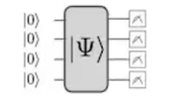
SQD workflow
0011...0011
0110...0100
1101...0110
...
1011...1110
Process samples with SQD
Eigenvectors
Eigenvalues
IBM Quantum | © 2024 IBM Corporation
Notes:
Using SQD in practice to approximate the eigenvalues and eigenvectors of a
Hamiltonian involves three main steps
1. The first step is to prepare a circuit on a quantum device. We want the target
wavefunction, for example the ground state we are trying to approximate, to
have significant support on the basis states generated by this circuit.
2. The second step is to draw noisy samples from that circuit.
3. And, the third step is to use SQD to classically process those noisy samples to
estimate the eigenvalues and eigenvectors of our Hamiltonian. For example, this
could be the ground state energy and wavefunction of a molecule.

Slide 38
SQD workflow
0011...0011
0110...0100
1101...0110
...
1011...1110
0011...0011
0110...0110
1001...0110
...
1001...1010
0011...0011
0110...0100
1101...0110
...
1011...1110
Configuration recovery
Batch 1
Batch N
Process samples with SQD
0110...0110
...
1001...1010
...
Subsample and create batches
...
Batch 1
Batch N
Project Hamiltonian and diagonalize
Eigenvector
Eigenvalue ...
Eigenvector
Eigenvalue ...
Eigenvectors
Eigenvalues
...
IBM Quantum | © 2024 IBM Corporation
Notes:
Let’s zoom in on what is happening in that classical postprocessing. This is an iterative
procedure, and each iteration has four steps:
1. First, a configuration recovery step flips the bits in some noisy samples using information about the input problem.
2. Second, the samples can be divided up into a set of smaller batches for easier processing.
3. Third, the Hamiltonian is projected and diagonalized in the subspaces spanned by each batch of samples.
4. Finally, we identify the batch with the lowest eigenvalue, or energy, and feed its information into the next iteration of SQD

